Slide 1
Reality Check – Parents Telling it Like it is!! Investing in Family Support 4 Scottsdale, Arizona

Slide 2
McClellan Family

Slide 3
Rollins Family
Children of Allison

Slide 4
Kelen
Grandchild of Annette Trammel

Slide 5
Hernandez Family

Slide 6
Kaiden and Kamry
Children of Shelby Willa

Slide 7
Steve McLeod Family

Slide 8
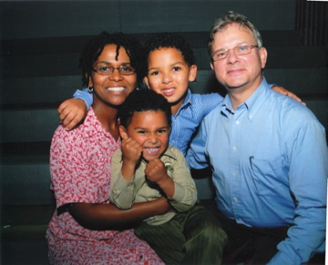
Carroll Family

